Slide 1
Image Processing Project
Megha Singh 19BCE1203
Chinmayee Das 19BCE1204
Parul Mudaliar 19BCE1531

Slide 2
LANE DETECTION

Slide 3
Problem Statement
Lane detection in Indian roads, constitute a major challenge due to the presence of obstacles and uneven road conditions. Due to the variance in structure and non-uniformity of the path, lane detection algorithms require additional assistance to ensure accuracy and safety to make self-driving cars, a reality in India.

Slide 4
Image Processing Techniques Used
Color Thresholding
Hough Transform
Canny Edge Detection

Slide 5
Color Thresholding
In color thresholding, we convert an image from color into a binary image, i.e., one that is simply black and white. This can then be used to select areas of interest of an image, while ignoring the parts we are not concerned with.

Slide 6
Canny Edge Detection
The Canny edge detector is an edge detection operator that uses a multi-stage algorithm to detect a wide range of edges in images. It was developed by John F. Canny in 1986.
The Canny edge detection algorithm is composed of 5 steps:
Noise reduction;
Gradient calculation;
Non-maximum suppression;
Double threshold;
Edge Tracking by Hysteresis.

Slide 7
Hough Transformation
The Hough Transform, patented by Paul V. C. Hough, was originally invented to recognize complex lines in photographs. The algorithm has been modified and enhanced to be able to recognize other shapes such as circles and quadrilaterals of specific types. For the Hough Transform algorithm, it is crucial to perform edge detection first to produce an edge image which will then be used as input into the algorithm.
Notes:
An edge point produces a cosine curve in the Hough Space. From this, if we were to map all the edge points from an edge image onto the Hough Space, it will generate a lot of cosine curves. If two edge points lay on the same line, their corresponding cosine curves will intersect each other on a specific (ρ, θ) pair. Thus, the Hough Transform algorithm detects lines by finding the (ρ, θ) pairs that have a number of intersections larger than a certain threshold. It is worth noting that this method of thresholding might not always yield the best result without doing some preprocessing like neighborhood suppression on the Hough Space to remove similar lines in the edge image.

Slide 8
LITERATURE SURVEY

Slide 9
EXISTING SYSTEMS | FEATURES OF EXISTING SYSTEMS | FEATURES OF PROPOSED SYSTEM
Lane Following Control with Sensor Fusion and Lane Detection | Both lane detection and surrounding cars are considered. The lane following system synthesizes data from vision and radar detections, estimates the lane center and lead car distance, and calculates the longitudinal acceleration and steering angle of the ego vehicle. | We are making it based on purely software vision in order to overcome any delay in the feedback mechanism involved in the existing system.

Slide 10
Realtime Road Boundary Detection and Vehicle Detection for Indian Roads | In the absence of prominent lanes in the road, the segmentation line itself acts as a boundary line. Further optical flow-based vehicle detection is integrated with the system. | We are using a series of techniques to get a better view of the road lanes and avoid any obstacle on the road.
Lane Detection Techniques using Image Processing | The paper views two approaches for lane detection. The first one being thresholding, in which color thresholding is done in order to detect the color of the road instead of detecting the lane markings. The second one, instead of using the entire road pixels, only the edges of the path are considered. | The proposed system aims to describe an approach to deal with the presence of obstacles in order to avoid the possibilities of damage in a self-driving vehicle for Indian roads. Even though, improved lane detection approach is considered, in the paper, the approach for dealing with presence of hurdles in the middle of the roads, is left out of focus.

Slide 11
A Much Advanced and Efficient Lane Detection Algorithm for Intelligent Highway Safety | The problem more focussed in this paper, is the presence of multiple lanes in the scenario. The approach for the same is, the idea of dividing the region of interest into two parts, before progressing with other image processing techniques. | The proposed system uses the region of interest approach, focusing on changing the perspective of the region, to advantage the image processing methods and provide higher accuracy in lane detection.
Recent progress in road and lane detection: A survey | The paper describes the recent developments in lane detection algorithms and real-time applications of the same. It describes the development of features including lane departure warning, adaptive cruise control, lane keeping, lane centring, lane change assist, turn assist etc. | The proposed system adds the clearance of lighting in areas of poor light conditions, for improved lane detection.

Slide 12
Methodology

Slide 13
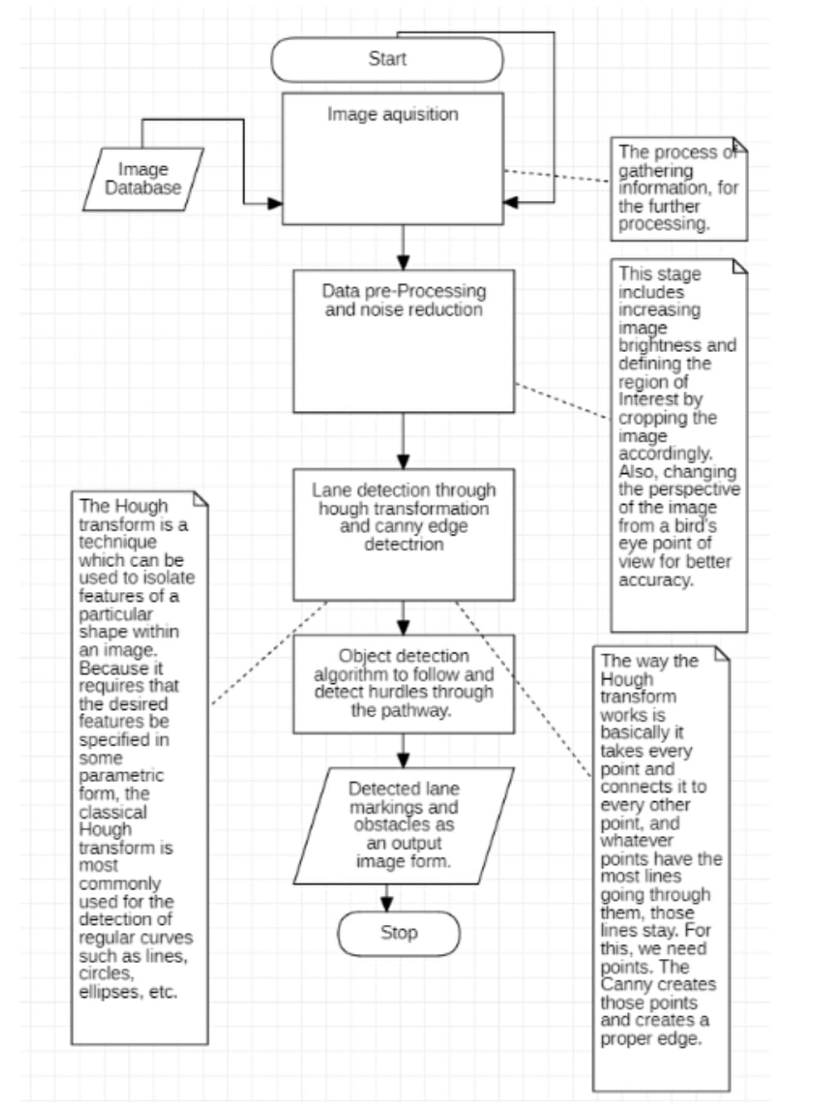

Slide 14
Implementation

Slide 15
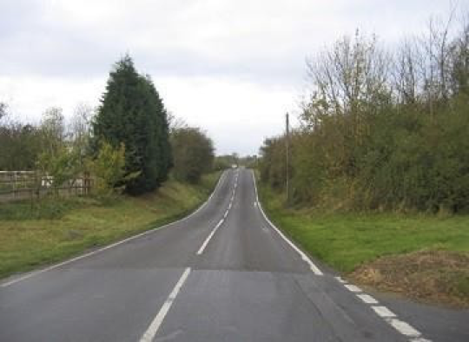
Original Image

Slide 16
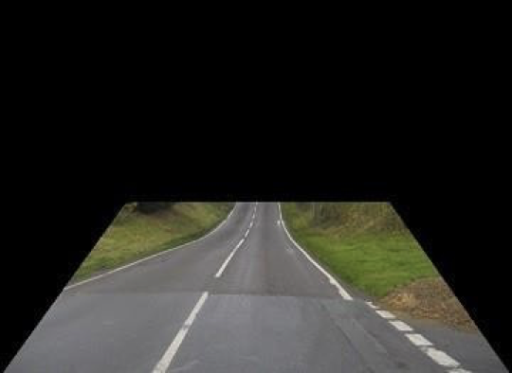
Finding Region of Interest

Slide 17

Bilateral Image

Slide 18
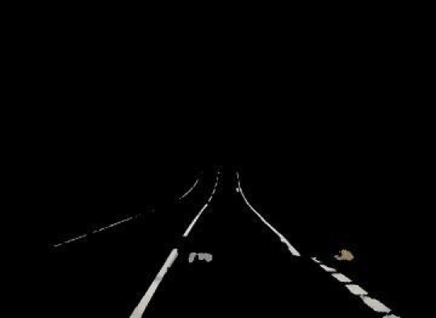
Color Thresholding

Slide 19
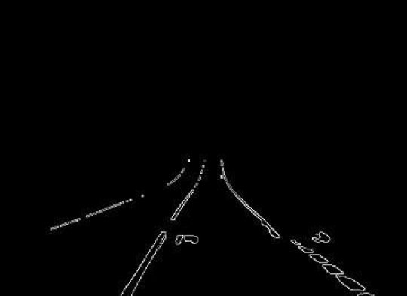
Canny Edge Detection

Slide 20
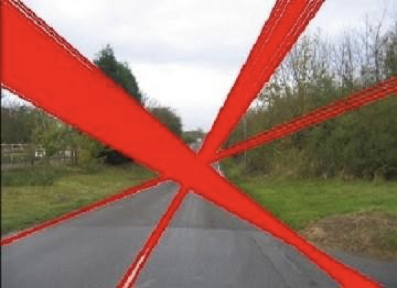
Hough Lines

Slide 21
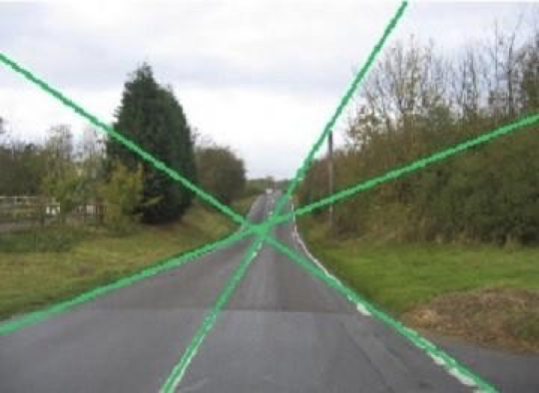
K-means Clustering

Slide 22
THANK YOU!!!

